Slide 1
“Disability is not inability”
Breaking barriers: Fostering Accessibility & Inoculation at the University of Barishal

Slide 2

About
I’m a student at the University of Barishal. The University of Barishal is a public university located in Barishal, Bangladesh. Established in 2011, it is one of the universities in the southern region of Bangladesh, and its reputation can be influenced by factors such as academic programs, faculty expertise, research output, infrastructure, and overall educational environment.
University of
Barishal

Slide 3




Goals and Objectives
Inclusive and accessible
Raise awareness
Collaborate and create network
Bridge the communication gap
Monitor and evaluate

Slide 4
FIELDWORKS
Regular team meeting to make plan and update
Offline and online survey with general students to learn their views on persons with disabilities
Administrations regarding facilities for diverse need
In Person Audit on every sectors of the campus
Campaigned and postered the whole campus with awareness statements
Created a community specially for Disabled students

Slide 5
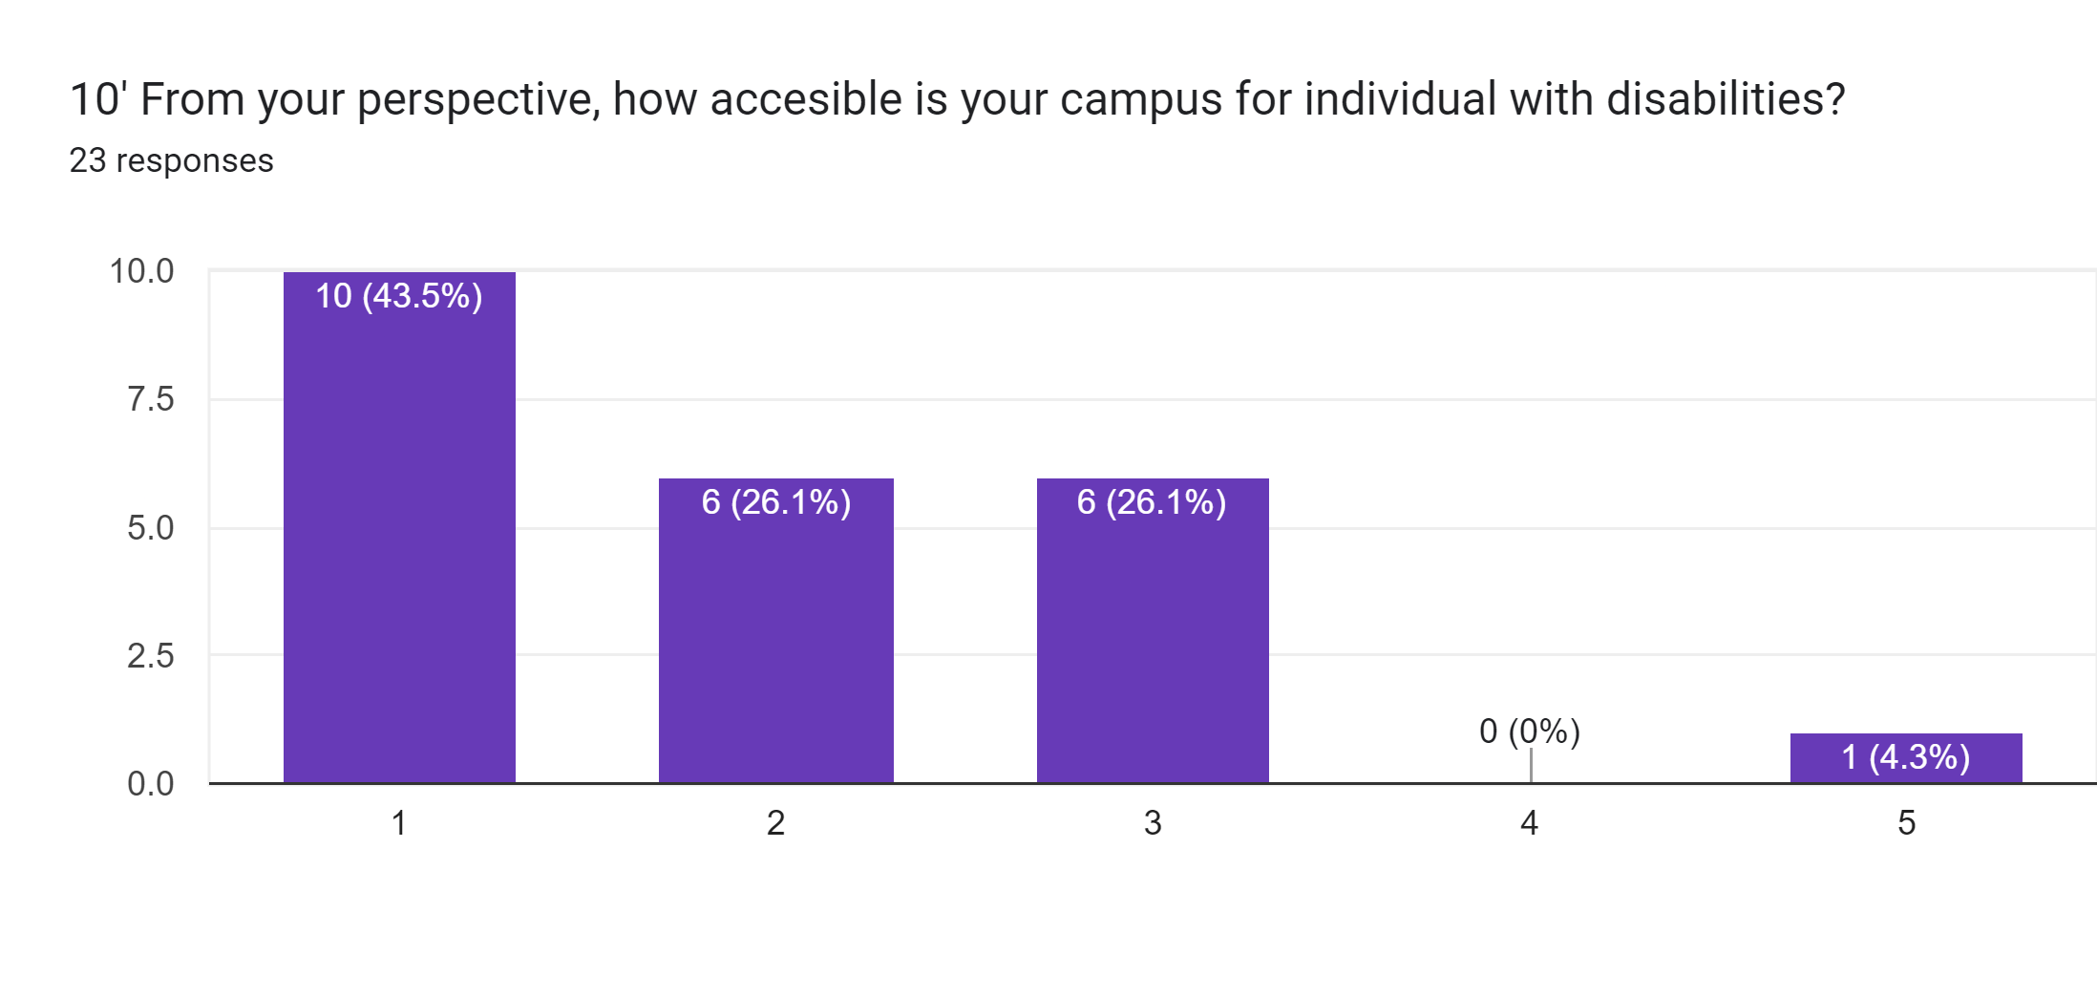
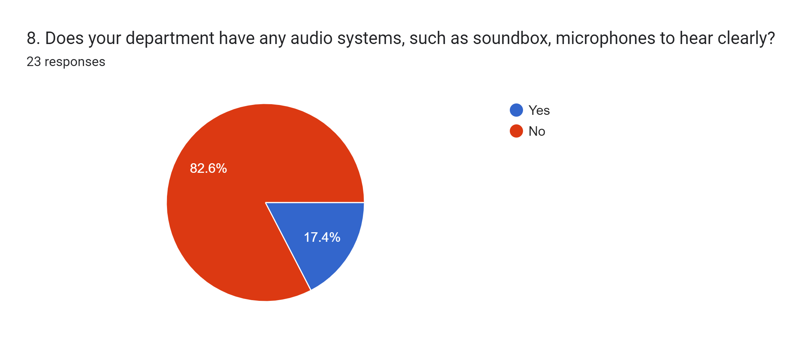

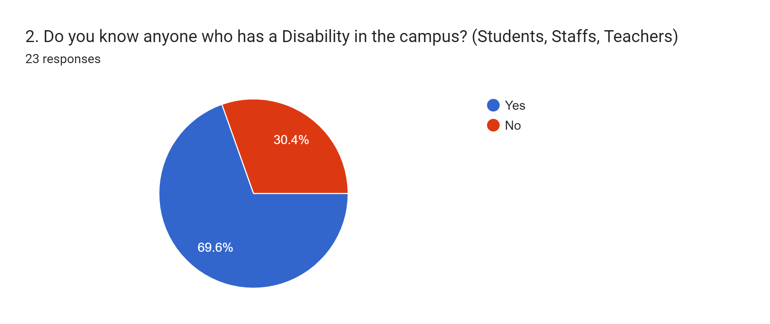
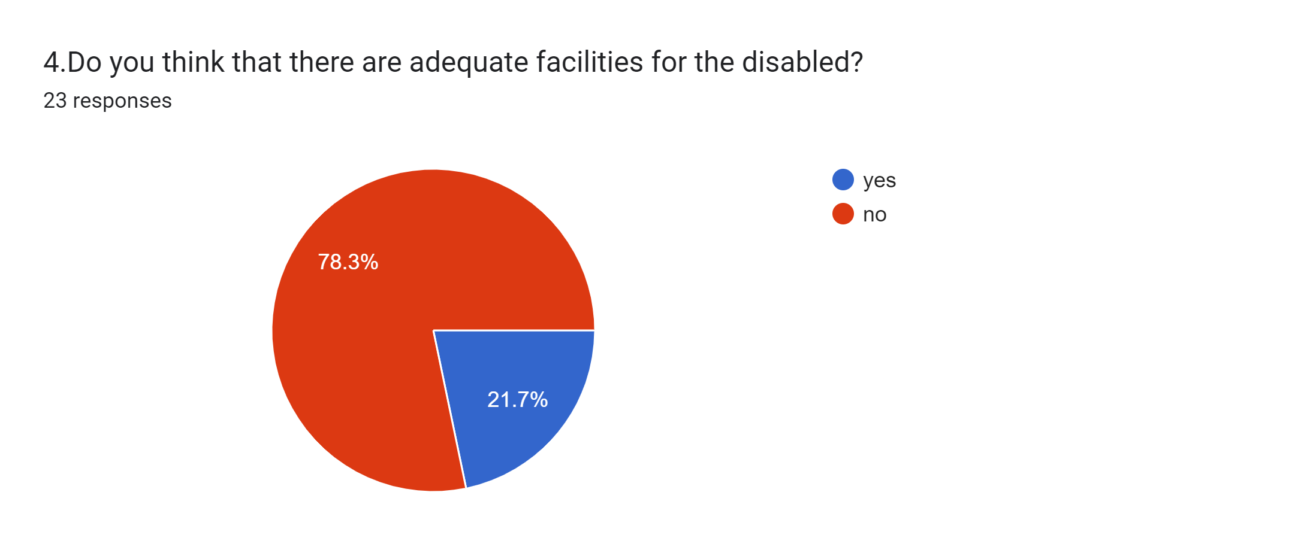
Student’s Point of View

Slide 6
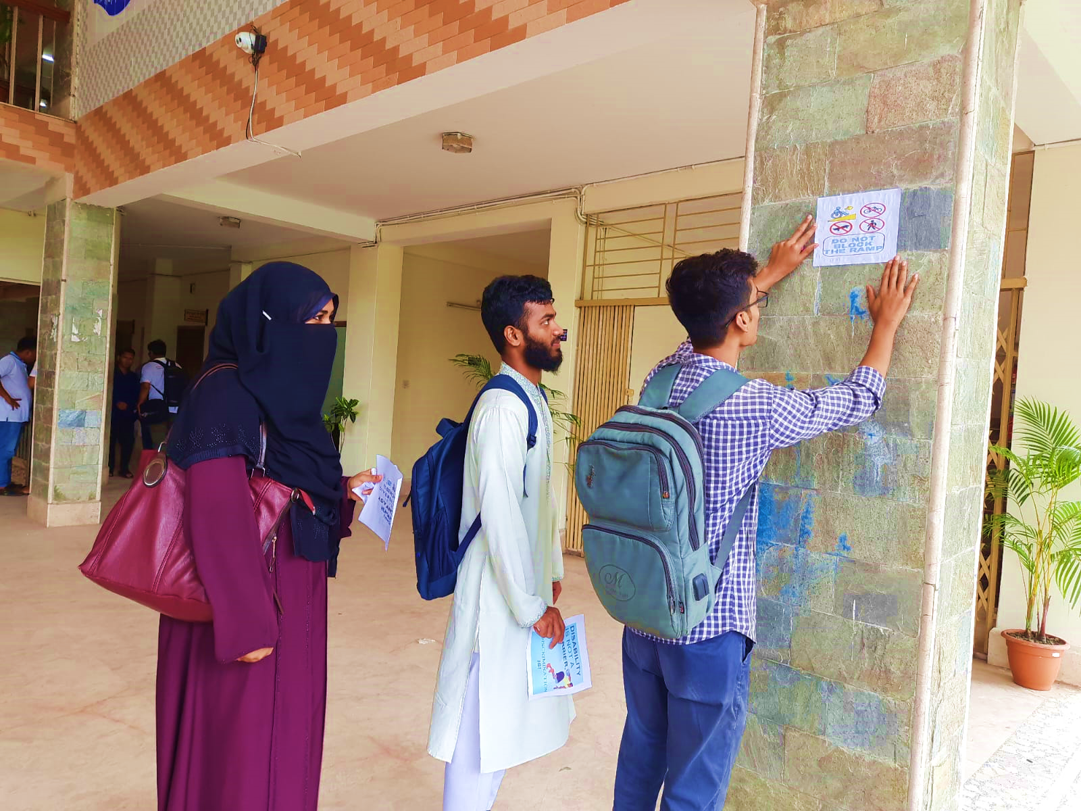
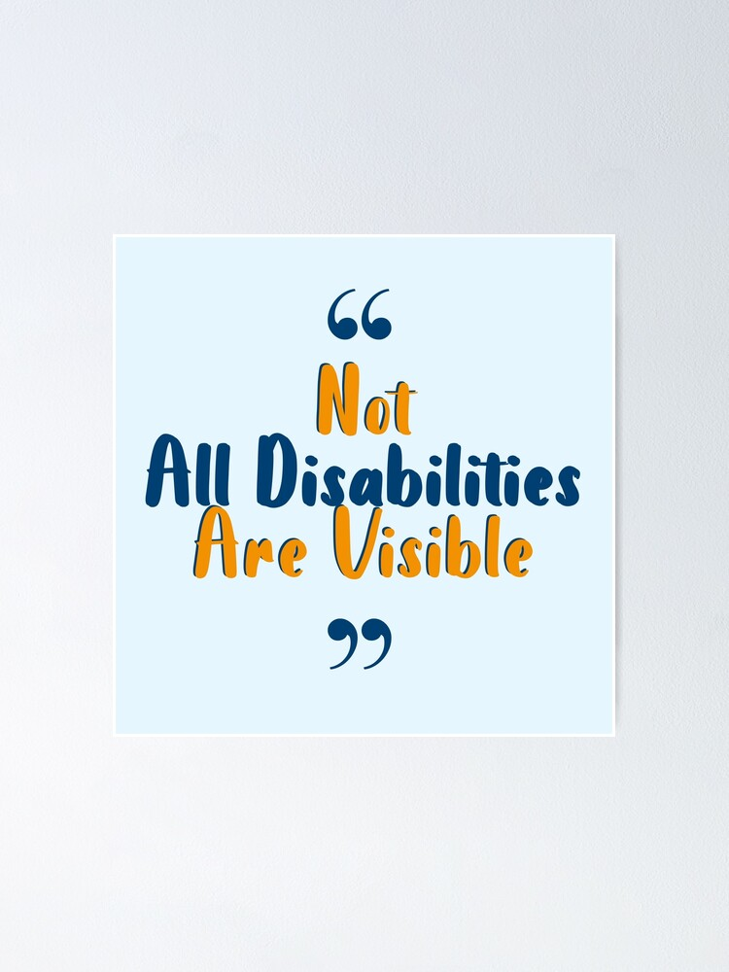

Postering all over the campus

Slide 7


Our Findings…
Infrastructural Lacking
Communication Gap
Minimum Facilities
Lack of awareness
Non Adjustable Furniture
Inaccessible Emergency Exits
Lack of Assistive Technology
Inadequate Parking
Non-Compliant Signage

Slide 8

CHALLENGES WE FACED
01
04
STEREOTYPE
MISBELIEF
02
05
FEAR
TIME SCHEDULE
03
06
INDIFFERENCE
NON-COOPERATION

Slide 9



Bringing them under a community
Future Plan
To ensure department based special consideration
A sustained accessible infrastructural development

Slide 10
An exciting event
EXPERIENCES
Learnt different way of learning
Mitigating issues concerning different opinions
01
02
Bonding with persons with disabilities
Better understaning of a situation
03
04

Slide 11
THANK
YOU

